Slide 1
Project on oopS (BUS RESERVATION)
DONE BY
K V NITHIYASRI -19S023
&
S GAYATHRI -19S010

Slide 2
FOUR FEATURES OF THIS PROJECT
Basically four features are available in this project
Install Bus Information
This feature allows you to install a typical bus information before it can be reserved by the passengers or shown in buses available. It includes the bus no., driver’s name, arrival time, departure time and destination (from and to) of the bus.

Slide 3
Reservation
This feature is very simple; it includes the bus no., seat number and the passenger’s name. The seat number of the particular bus is reserved under the passenger’s name.
Show Reservation Information
With this feature, you can show all the information regarding the buses and their respective seats. It contains all the information stored by the previous two function of this project. It also enlists the no. of empty seats in a bus along with the seat number registered to a particular passenger.
Buses Available
This feature simply shows the buses available for reservation, and the information regarding the bus no. stored under the first feature.

Slide 4
concepts used
1.CONDITIONAL STATEMENTS
2.STATIC DATA MEMBER
3.ENCAPSULATION
4.ABSTRACT (ACCESS SPECIFIERS)
5.MANUPULATOR(SETFILL,SETWIDTH)
6.POLYMORPHISM(VIRTUAL FUNCTION)
7.FRIEND FUNCTION
8.STRUCTURE
9.FUNCTION OVERLOADING
10.STRING FUNCTIONS
11.LOOPING STATEMENTS

Slide 5
CODE
#include <conio.h>
#include <cstdio>
#include <iostream>
#include <string.h>
#include <cstdlib>
using namespace std;
static int p = 0;
class a
{
char busn[5], driver[10], arrival[5], depart[5], from[10], to[10], seat[8][4][10];
public:

Slide 6
void install();
void allotment();
void empty();
void show();
friend void avail();
virtual void position(int i);
}
bus[10];
void vline(char ch)
{
for (int i=80;i>0;i--)
cout<<ch;
}

Slide 7
void a::install()
{
cout<<"Enter bus no: ";
cin>>bus[p].busn;
cout<<"\nEnter Driver's name: ";
cin>>bus[p].driver;
cout<<"\nArrival time: ";
cin>>bus[p].arrival;
cout<<"\nDeparture: ";
cin>>bus[p].depart;
cout<<"\nFrom: \t\t\t"; cin>>bus[p].from;
cout<<"\nTo: \t\t\t"; cin>>bus[p].to;

Slide 8
bus[p].empty();
p++;
}
void a::allotment()
{
int seat;
char number[5];
top:
cout<<"Bus no: ";
cin>>number;
int n;

Slide 9
for(n=0;n<=p;n++)
{
if(strcmp(bus[n].busn, number)==0)
break;
}
while(n<=p)
{
cout<<"\nSeat Number: ";
cin>>seat;
if(seat>32)
{
cout<<"\nThere are only 32 seats available in this bus.";

Slide 10
}
else
{
if (strcmp(bus[n].seat[seat/4][(seat%4)-1], "Empty")==0)
{
cout<<"Enter passanger's name: ";
cin>>bus[n].seat[seat/4][(seat%4)-1];
break;
}
else
cout<<"The seat no. is already reserved.\n";
}

Slide 11
}
if(n>p)
{
cout<<"Enter correct bus no.\n";
goto top;
}
}
void a::empty()
{
for(int i=0; i<8;i++)
{
for(int j=0;j<4;j++)

Slide 12
{
strcpy(bus[p].seat[i][j], "Empty");
}
}
}
void a::show()
{
int n;
char number[5];
cout<<"Enter bus no: ";
cin>>number;
for(n=0;n<=p;n++)
{

Slide 13
if(strcmp(bus[n].busn, number)==0)
break;
}
while(n<=p)
{
vline('-’);
cout<<"Bus no: \t"<<bus[n].busn
<<"\nDriver: \t"<<bus[n].driver<<"\t\tArrival time: \t"
<<bus[n].arrival<<"\tDeparture time:"<<bus[n].depart
<<"\nFrom: \t\t"<<bus[n].from<<"\t\tTo: \t\t"<<
bus[n].to<<"\n";
vline('-');

Slide 14
bus[0].position(n);
int a=1;
for (int i=0; i<8; i++)
{
for(int j=0;j<4;j++)
{
a++;
if(strcmp(bus[n].seat[i][j],"Empty")!=0)
cout<<"\nThe seat no "<<(a-1)<<" is reserved for "<<bus[n].seat[i][j]<<".";
}
}
break;
}

Slide 15
if(n>p)
cout<<"Enter correct bus no: ";
}
virtual void a::position(int l)
{
int s=0;p=0;
for (int i =0; i<8;i++)
{
cout<<"\n";
for (int j = 0;j<4; j++)
{
s++;

Slide 16
if(strcmp(bus[l].seat[i][j], "Empty")==0)
{
cout.width(5);
cout.fill(' ');
cout<<s<<".";
cout.width(10);
cout.fill(' ');
cout<<bus[l].seat[i][j];
p++;
}
else
{

Slide 17
cout.width(5);
cout.fill(' ');
cout<<s<<".";
cout.width(10);
cout.fill(' ');
cout<<bus[l].seat[i][j];
}
}
}
cout<<"\n\nThere are "<<p<<" seats empty in Bus No: "<<bus[l].busn;
}

Slide 18
void avail()
{
for(int n=0;n<p;n++)
{
vline('*');
cout<<"Bus no: \t"<<bus[n].busn<<"\nDriver: \t"<<bus[n].driver
<<"\t\tArrival time: \t"<<bus[n].arrival<<"\tDeparture Time: \t"
<<bus[n].depart<<"\nFrom: \t\t"<<bus[n].from<<"\t\tTo: \t\t\t"
<<bus[n].to<<"\n";
vline('*');
vline('_');
}
}

Slide 19
int main()
{
system("cls");
int w;
while(1)
{
cout<<"\n\n\n\n\n";
cout<<"\t\t\t1.Install:\n\t\t\t"
<<"2.Reservation:\n\t\t\t"
<<"3.Show:\n\t\t\t"
<<"4.Buses Available:\n\t\t\t"
<<"5.Exit";

Slide 20
cout<<"\n\t\t\tEnter your choice:-> ";
cin>>w;
switch(w)
{
case 1: bus[p].install();
break;
case 2: bus[p].allotment();
break;
case 3: bus[0].show();
break;
case 4: bus[0].avail();

Slide 21
break;
case 5: exit(0);
}
}
cout<<"Have a happy and safe journey";
return 0;
}

Slide 22
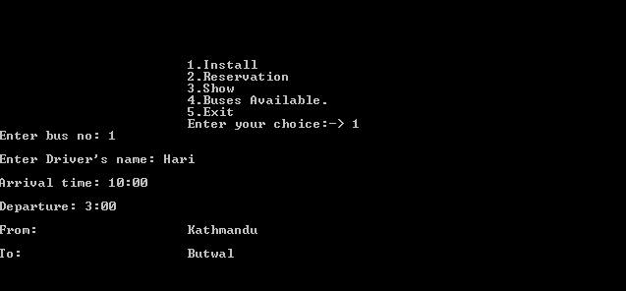
CHOICE NO : 1 INSTALL

Slide 23
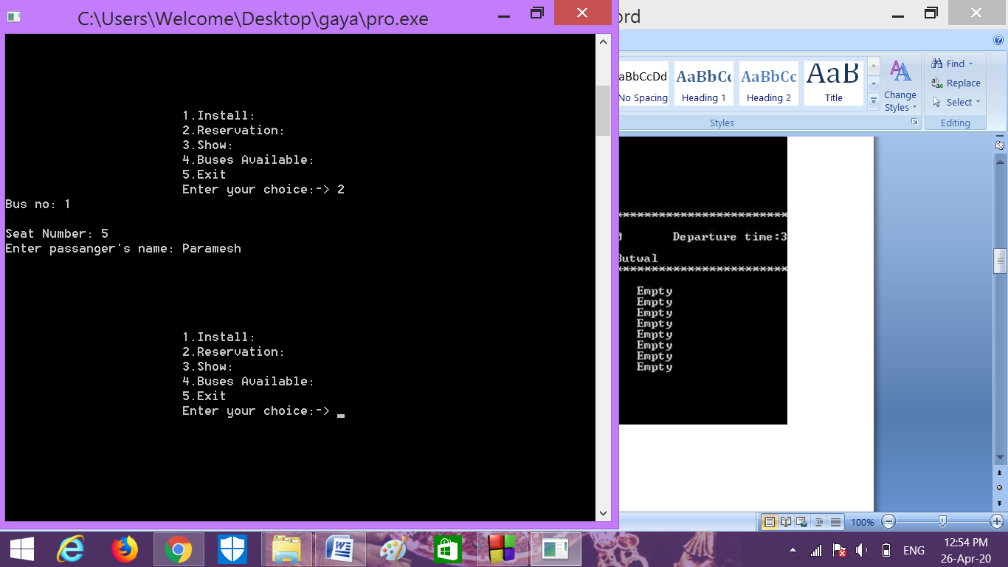
CHOICE NO : 2 RESERVATION

Slide 24
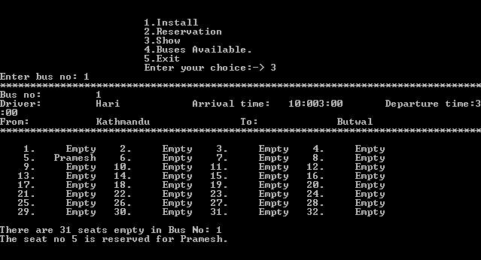
CHOICE NO : 3 SHOW

Slide 25
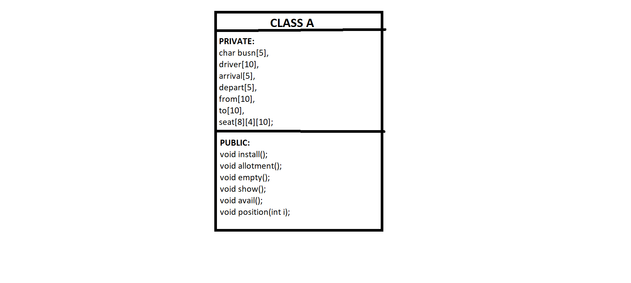
Class diagram
CLASS A

Slide 26


